Slide 1
Disaster Preparedness and Response Education System for
Schools and Colleges
CSE7302- University Project
Review-1
Batch Number: CIT_32
Under the Supervision of,
Ms. Pushpalatha M,
Assistant Professor,
School of Computer Science and Engineering,
Presidency University.
Roll Number | Student Name
20221CIT0130 | Nithya H D
20221CIT0126 | Shreya A J
20221CIT0123 | Manisha S M
Name of the Program:
Name of the HoD: Dr. Anandaraj SP
Name of the Program Project Coordinator: Dr. Sharmasth Vali
Name of the School Project Coordinators: Dr. Sampath A K , Dr. Geetha A

Slide 2
Problem Statement Number:SIH25008
Organization: Presidency University
Category (Hardware / Software / Both) :Software
Problem Description:
In India, schools and colleges are often unprepared for natural disasters such as earthquakes, floods, and fires. While emergency guidelines exist on paper, there is a lack of structured disaster management education integrated into the curriculum. Institutions lack digital tools to simulate disaster scenarios or conduct virtual drills to train students and staff on safety protocols.
Furthermore, there’s a gap in localized awareness—many students are unaware of how to react during disasters specific to their region. Manual drills, where they occur, are infrequent and often poorly coordinated, failing to instill practical preparedness.

Slide 3
Content
Problem Statement
Objectives
Background and Related work for title Selection
Analysis of Problem Statement
Innovation or Novel Contributions
Git-hub Link
Timeline of the Project
References

Slide 4
Background and Related work for title Selection
India frequently faces natural disasters such as floods, earthquakes, and fires, making disaster preparedness essential in educational institutions.
Schools and colleges currently rely on theoretical guidelines with minimal practical training.
Existing research mainly focuses on general disaster management systems rather than student-centered education.
Few studies address digital learning platforms or virtual simulations for disaster preparedness in schools and colleges.
Hence, this project is proposed to provide practical, digital, and structured disaster education for students.

Slide 5
Objectives
To design and develop a digital disaster preparedness and response education system that equips students and staff in schools and colleges with structured, practical knowledge to effectively respond to natural disasters.
To provide region-specific disaster awareness by educating users about disasters commonly occurring in their geographical area (such as floods, earthquakes, cyclones, or fires).
To simulate real-life disaster scenarios through virtual drills and interactive modules, enabling students to practice safety protocols in a risk-free environment.
To improve preparedness and response skills of students and staff by training them on evacuation procedures, first aid, emergency communication, and safety measures.
To overcome limitations of manual disaster drills by offering frequent, scalable, and well-coordinated digital training sessions.
To promote a culture of safety and resilience within educational institutions by encouraging continuous learning and awareness in disaster risk reduction.

Slide 6
Analysis of Problem Statement
Many schools and colleges in India are not well prepared for natural disasters like floods, earthquakes, and fires.
Although safety guidelines exist, they are mostly on paper and not practiced regularly.
Disaster management is not part of regular education, so students lack proper awareness and confidence.
Manual drills are rare and ineffective, giving little real-life experience.
There are no digital tools or simulations to train students for disaster situations.
This highlights the need for a digital disaster preparedness and response education system to improve awareness, readiness, and safety among students and staff.

Slide 7
Analysis of Problem Statement
Technology Stack Components:
Frontend: HTML, CSS, JavaScript – for building a responsive and user-friendly interface
Backend: Java / Python (Flask/Django) / Node.js – for handling application logic and user management
Database: MySQL / MongoDB – to store user data, training records, and assessment results
Simulation & Learning Modules: Interactive web-based simulations and quizzes for disaster scenarios
Deployment Platform: Cloud-based hosting (AWS / Azure / Local Server) for scalability and accessibility
Tools & APIs: Maps API, Notification services, and Analytics tools for location-based awareness and performance tracking

Slide 8
Analysis of Problem Statement (contd...)
Software Requirements:
Operating System: Windows / Linux / macOS
Frontend Technologies: HTML, CSS, JavaScript
Backend Technologies: Java / Python / Node.js
Database: MySQL / MongoDB
Web Browser: Google Chrome / Mozilla Firefox
Development Tools: VS Code / IntelliJ / Eclipse
Hardware Requirements:
Processor: Intel i3 or higher
RAM: Minimum 4 GB (8 GB recommended)
Storage: Minimum 100 GB free space
Internet Connection: Required for online access and updates

Slide 9
Github Link
The Github link provided should have public access permission.
Github Link

Slide 10
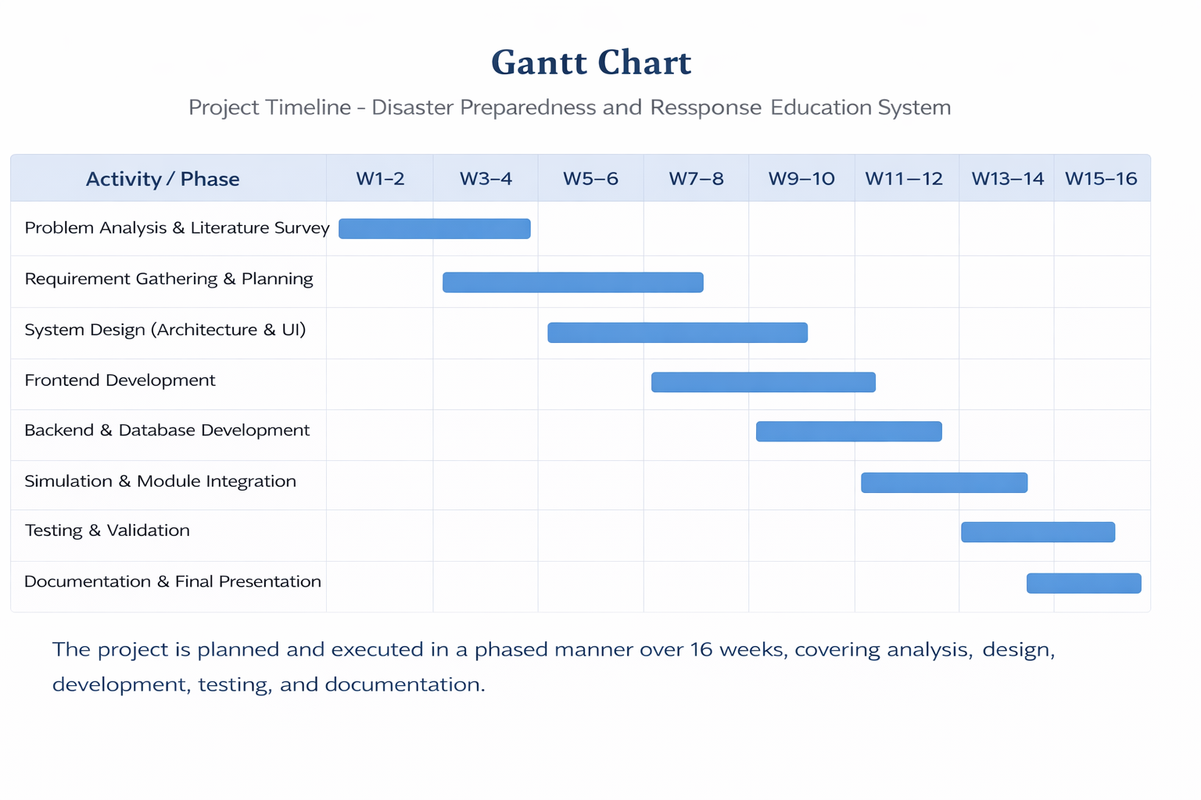
Timeline of the Project (Gantt Chart)

Slide 11
References (IEEE Paper format)
  [1]
  S. Shaw, R. Takeuchi, and S. K. Jain,
  “Disaster education and preparedness: A systematic review of school-based disaster risk reduction programs,”
  [2] A. R. Mishra and P. K. Singh,
  “A digital framework for disaster preparedness and emergency response training using simulation-based learning,”

Slide 12


